Slide 1

AI ASSISTANCE FOR RESUME ANALYSIS AND INTERVIEW EVALUATION
Altamas Nehal : 99220040423
Avinash Kumar : 99220040442
Sai Vignesh : 99220040397
Md Musthafa : 99220040402
Mentor :- Dr M K Nagarajan TEAM :- 04

Slide 2

Problem Statement
The traditional recruitment process is time-consuming, biased, and inefficient due to manual resume screening and interviews. There is a need for an AI-based system to automate candidate evaluation, improve accuracy, reduce bias, and streamline the hiring process effectively.

Slide 3





Proposed Solution
Our platform offers a comprehensive, secure, and scalable ecosystem built using PERN stack.
Develop an AI-based system to automatically analyze and rank resumes..
Implement an intelligent interview engine to generate and
ask questions dynamically..
Use NLP techniques to evaluate candidate responses in real time.
Provide automated scoring and feedback to support unbiased
decision making.

Slide 4
Literature Survey
Journal/Year | Author | Methodology | Research Gap
International Journal of Computer Science, 2025 | Mehtap Saatcı et al, Zeynep Hilal Kilimci | NLP and Machine Learning used for resume parsing and job matching | Cannot evaluate soft skills and contextual understanding
International Journal of Computer Applications, 2025 | K. R. Shinde, S. B. Patil | Automated resume classification using ML algorithms | No integration with interview systems

Slide 5
Literature Survey
Journal/Year | Author | Methodology | Research Gap
International Journal of Research in Engineering Science and Management, 2025 | A. Sharma, R. Gupta, P. Verma | NLP-based resume analysis and job matching | Focuses only on resume screening, lacks full recruitment system
Expert Systems with Applications (Elsevier), 2025 | C. K. Weng | LLM-based resume processing with chatbot interaction | Limited evaluation metrics for candidate performance

Slide 6
Literature Survey
Journal/Year | Author | Methodology | Research Gap
ResearchGate Publication, 2025 | Moses Blessing | AI-driven recruitment using NLP and predictive analytics | Bias and fairness issues not fully addressed
Decision Analytics Journal (Elsevier), 2025 | D. Kumar, S. Singh | IFairness-aware ML and Explainable AI (XAI) | No complete system integration (resume + interview)

Slide 7








Existing Overview
Recruitment is mainly done through manual resume screening by HR teams..
Interviews are conducted manually, requiring significant time and coordination.
Shortlisting candidates depends on
human judgment, leading to bias
and inconsistency.
Existing systems lack automation, real-time evaluation, and intelligent decision-making capabilities.

Slide 8
Proposed Overview
An AI-based system automatically analyzes and ranks resumes based on skills and job requirements.
NLP techniques evaluate candidate responses in real time for accuracy and relevance.
A smart interview module generates
and conducts dynamic, role-based
questions.
The system provides automated scoring, feedback, and data storage for unbiased decision making.

Slide 9
Software Requirements
Java for backend data
HTML , CSS, JavaScript for Frontend
Tools/Libraries :NLP

Slide 10
List of Modules
User Authentication Module :- Handles login and registration of users (admin/recruiter). Ensures secure access to the system.
Resume Upload & Parsing Module: Allows candidates to upload resumes and uses NLP techniques to extract key details like skills, education, and experience.
Resume Analysis Module :-Analyzes and ranks resumes based on job requirements using AI/ML algorithms.
Job Description Management Module:-Enables recruiters to create, update, and manage job roles and required skills.
Interview Generation Module :-Generates dynamic and role-based interview questions automatically using AI.

Slide 11
List of Modules
Interview Evaluation Module :-Evaluates candidate responses using NLP and provides scores based on relevance and correctness.
Database Management Module:-Stores candidate details, resumes, interview results, and scores using SQL.
Reporting & Feedback Module :-Generates reports and provides feedback on candidate performance for better decision making.

Slide 12
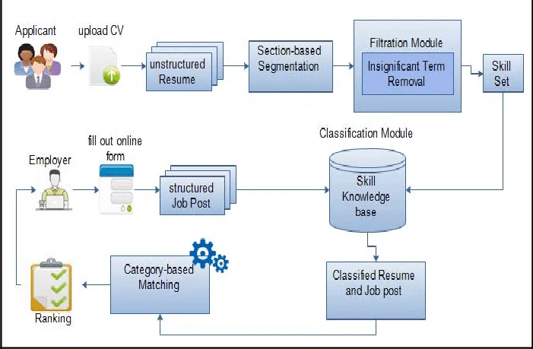
Overall Architecture
interview

Slide 13
Result and Discussion
The proposed system significantly improves recruitment efficiency by automating resume screening and interview evaluation. It reduces human bias and ensures consistent candidate assessment using AI and NLP techniques. The system provides faster processing, accurate ranking, and real-time feedback. Overall, it enhances decision making, saves time, and offers a scalable solution for modern hiring processes.

Slide 14
Conclusion
The proposed AI-based system successfully automates resume analysis and interview evaluation, improving efficiency, accuracy, and consistency in recruitment. By using NLP and machine learning techniques, it reduces human bias and manual effort. The system ensures faster candidate screening and better decision making, making it a reliable solution for modern hiring processes.

Slide 15
Future Enhancements
Integration of voice-based interviews using speech recognition
Use of advanced AI models for deeper skill and emotion analysis.
Real-time video interview analysis with facial expression detection.
Integration with job portals like LinkedIn for automated hiring.
Improved explainable AI for transparent and fair decision making.

Slide 16
References
M. Saatcı and Z. H. Kilimci, “Resume Screening with Natural Language Processing (NLP),” International Journal of Computer Science, 2025.
K. R. Shinde and S. B. Patil, “AI-Based Resume Screening System,” International Journal of Computer Applications, vol. XX, no. XX, 2025.
A. Sharma, R. Gupta, and P. Verma, “AI-Powered Automated Resume Screening and Job Matching System Using NLP and Machine Learning,” International Journal of Research in Engineering Science and Management, 2025.
C. K. Weng, “AI Resume Screening and Chatbot Integration Using Large Language Models,” Expert Systems with Applications, Elsevier, 2025..

Slide 17
References
M. Blessing, “AI-Powered Resume Screening: Benefits and Challenges,” ResearchGate Publication, 2025.
D. Kumar and S. Singh, “Fair and Transparent AI-Driven Resume Screening Using Explainable AI,” Decision Analytics Journal, Elsevier, 2026.

